Slide 1
A Natural Language Processing Analysis of Sustainability Reports and its Relationship with Corporate Financial Performance: Empirical Evidence from Singapore’s Listed Companies
Jeremy Chia
ESCP Business School
MSc Big Data and Business Analytics, 2021/2022
Supervised by:
Associate Professor Man Ching Gladie LUI
ESCP Business School
Financial Reporting & Audit

Slide 2
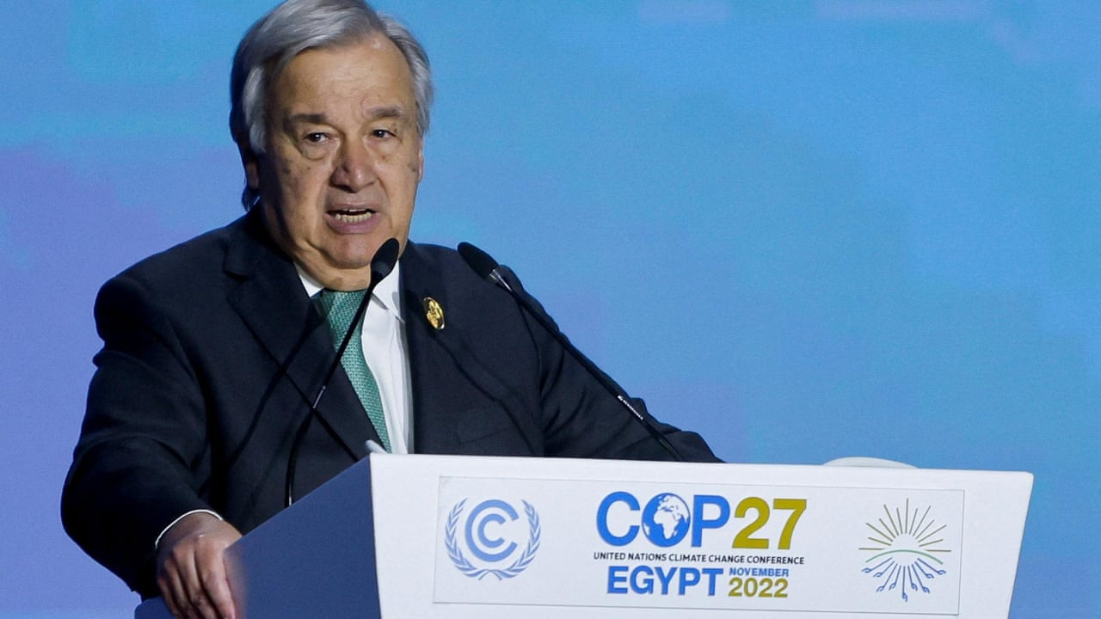

We are in the fight of our lives, and we are losing … And our planet is fast approaching tipping points that will make climate chaos irreversible. “We are on a highway to climate hell with our foot on the accelerator.”
António Guterres
Secretary-General of the United Nations
Nov 7, 2022
Notes:
Reference: https://www.theguardian.com/environment/2022/nov/07/cop27-climate-summit-un-secretary-general-antonio-Guterres

Slide 3
Singapore, Companies, and Disclosures
What has Singapore and what have companies in Singapore done so far?
Notes:
Introduction – Explain the need for this study

Slide 4
CSR vs ESG, Past and Present
How have attitudes towards CSR, ESG changed?
Notes:
Introduction – Explain the need for this study

Slide 5
Sustainability Disclosures
How has this evolved, and why?
Notes:
Introduction – Explain the need for this study

Slide 6
Sustainability Reporting Standards
How may sustainability disclosures be standardised?
Notes:
Introduction – Explain the need for this study

Slide 7
Theories in Sustainability Reporting and Financial Performance
How may these two aspects of companies’ be related?
Notes:
Literature review – Explain what other scholars have found on the subject

Slide 8
Prior Approaches
How was this topic studied previously?
Notes:
Literature review – Explain what other scholars have found on the subject

Slide 9
Research Questions
What are the questions this study proposes to address?
What are the most prominent topics in sustainability reports from an exploratory topic modelling analysis? Will this resemble the disclosure themes in frameworks like the GRI?
How do these topics identified in RQ 1 relate to CFP?
How do a sustainability report's readability and sentiment score relate to corporate financial performance?
Are there material differences in the relationship between CSR disclosures and CFP at this point, vis-à-vis prior studies conducted by Tsang, 1998 and Loh et al., 2017?
Notes:
Research methodology – What research method did you use, and why did you use it?

Slide 10


Data Sources and Methodology
How will the research questions be answered?
Explanatory Variables
Financials from Bloomberg Terminal
Target Variables
Sustainability Reports from SGX
(with pre-
processing,
NLP applied)
OLS Regression
Ohlson’s Model
Topics ($k=7$) [RQ1,2]
Return on Assets
Sentiment [RQ 3]
Market Value $(t+4)$
Readability [RQ 3]
Zmijewski Score
Compared with prior studies [RQ 4]
Notes:
Research methodology – What research method did you use, and why did you use it?

Slide 11

Explanatory Variables
What factors are considered for sustainability reports?
Topics ($k=7$)
Sentiment
Readability
Notes:
Research methodology – What research method did you use, and why did you use it?

Slide 12

Target Variables
What factors are considered for financial performance?
Return on Assets
Market Value $(t+4)$
Zmijewski Score
Notes:
Research methodology – What research method did you use, and why did you use it?

Slide 13
Model and Hypothesis
What was being tested, and how?
Notes:
Research methodology – What research method did you use, and why did you use it?

Slide 14
Insights from Exploratory Data Analysis
What were some trends seen from the data?
Notes:
Findings and discussions – In your research, what were the key deductions that you came upon?

Slide 15
Analysis on Return on Assets
What is a sustainability report’s influence on the company’s profitability?
Notes:
Findings and discussions – In your research, what were the key deductions that you came upon?

Slide 16
Analysis on Market Value
What is a sustainability report’s influence on the company’s valuation by investors?
Notes:
Findings and discussions – In your research, what were the key deductions that you came upon?

Slide 17
Analysis on Zmijewski Score
What is a sustainability report’s influence on the company’s valuation by investors?
Notes:
Findings and discussions – In your research, what were the key deductions that you came upon?

Slide 18
Comparison with Prior Studies
What are the similarities and differences with these findings?
Notes:
Findings and discussions – In your research, what were the key deductions that you came upon?

Slide 19
Conclusion
Summing up: What was found, and what next?
Notes:
Implications, limitations, suggestions, and conclusion – Here, you have to exhaust the setbacks you encountered during the study, the consequences that your target audience will face if they do not follow the deductions, and then finally sum up the discussions.

Slide 20
Limitations of this Study
What are some opportunities for further studies?
Notes:
Implications, limitations, suggestions, and conclusion – Here, you have to exhaust the setbacks you encountered during the study, the consequences that your target audience will face if they do not follow the deductions, and then finally sum up the discussions.

Slide 21
A Natural Language Processing Analysis of Sustainability Reports and its Relationship with Corporate Financial Performance: Empirical Evidence from Singapore’s Listed Companies
Jeremy Chia
ESCP Business School
MSc Big Data and Business Analytics, 2021/2022
Supervised by:
Associate Professor Man Ching Gladie LUI
ESCP Business School
Financial Reporting & Audit

